Slide 1
Food Oasis
Sprint 4 - November 19th, 2019
Project Manager: Minhaj Shujauddin
Scrum Master: Stephen Gilbert
Programmers: Mike Fanor and Daniel Green
Q&A: Paulyn Monasterio

Slide 2
Overview
Burndown Chart
Velocity Chart
Product
Value
Completed Stories
Design Pattern
Backlog Stories

Slide 3
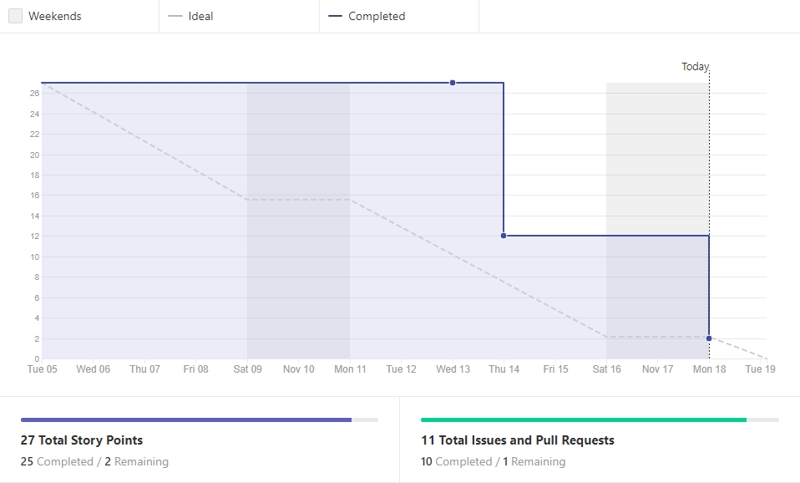
Burndown Chart
Notes:
- didnt start closing out issues until wednesday, didnt close on time
Managed to get everyone in check on wednesday
Had 1 individual group meeting
2 group meetings w/ other teams

Slide 4
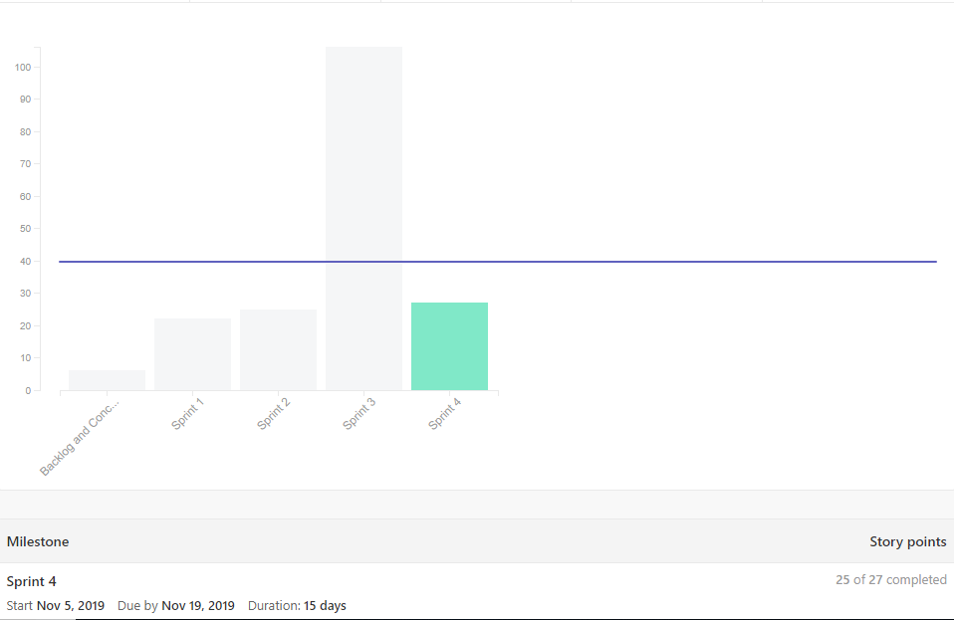
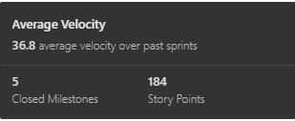
Velocity Chart
Notes:
-average velocity is 36.8
- finished a total 184 story points
- for our last sprint, we mentioned that we had a lot of catching up to do
- thats is why there is a huge spike

Slide 5
Product
We are developing an Android application called Food Oasis that uses geolocation to help users that live in food deserts search for quality food sources that are available nearby.
Our Android application had features that allow vendors to create an account and display quality food items that are either low cost or free.
Users will also be able to see the vendor’s location details such as phone number, address, working hours and the rating of the vendor’s quality of food.
Notes:
-creating a android application that uses geolocation to help users who live in food deserts to find healthy food.
- It enables vendors to create account & display food items (low cost or free).
- also users are able to see the vendor’s location details (phone #, address, hours, and the rating of vendor’s food.

Slide 6
What is the Value of Food Oasis?
We believe our product is very valuable because of this ongoing dilemma in society, as has been discussed prior.
We know that there are many health problems that are associated to eating these type of unhealthy options.
Our technology can raise awareness of healthy food options and reduce risks.
Our application can increase revenue for small vendors and increase their reach in communities.
Notes:
-we believe our product is valuable because of the problem that persists in our society
-we know there are alot of health problems that are associated w/ eating unhealthy
- our application raises awareness in picking healthy food options.
- + this app paves a way for small vendors to increase their attention to their name and revenue.

Slide 7
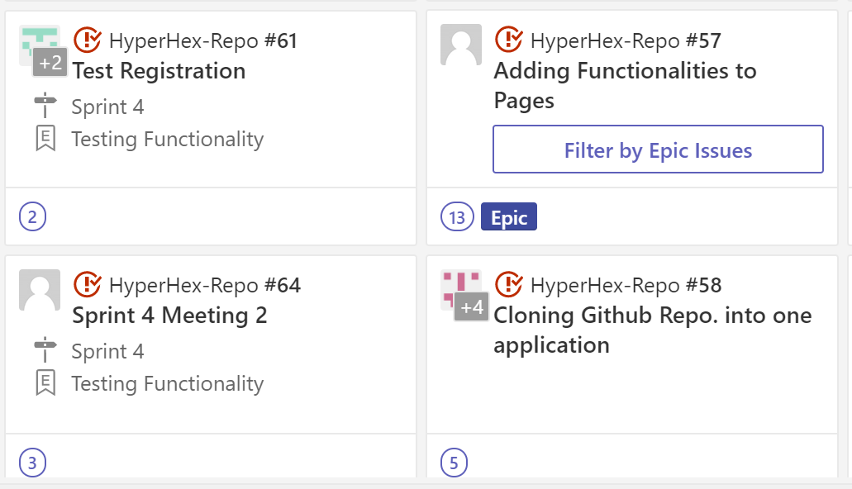
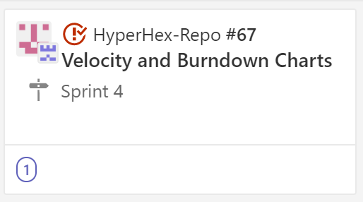
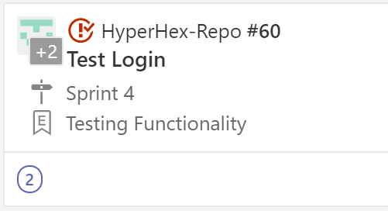
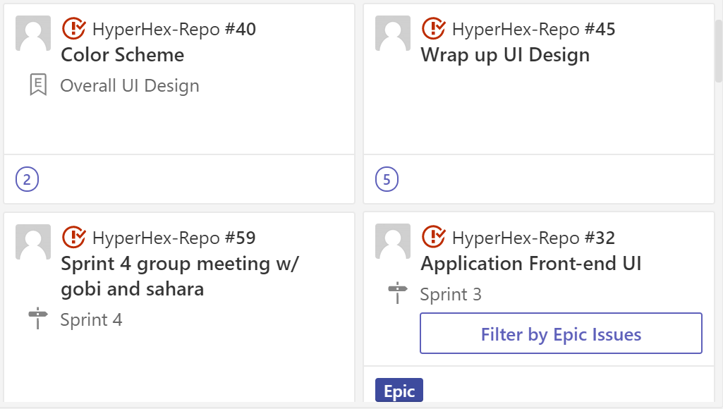
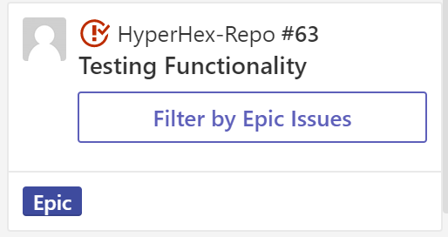
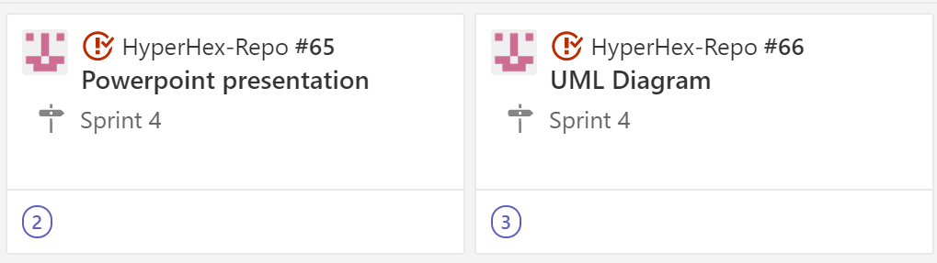
Completed Stories

Slide 8
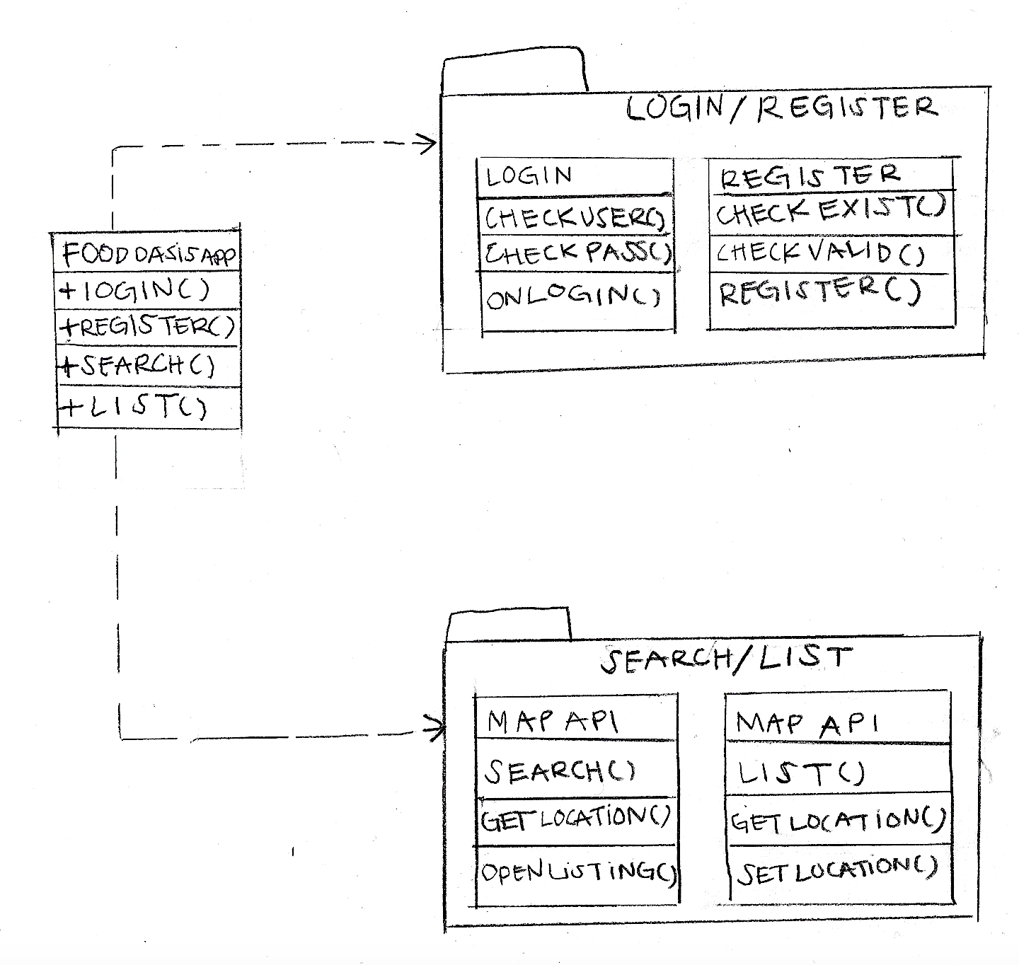
Façade
All of the groups in Food Oasis are using Façade, HyperHex included.
Natural fit for a mobile app.
Keep functionality simple, intuitive.
Minimize steps between user and food.
There are two main examples:
Login/Registration
Search/Listing
Both involve accessing external resources.
Firebase, Google Maps
Since we are in charge of the forwards facing app, it’s especially relevant to us.

Slide 9
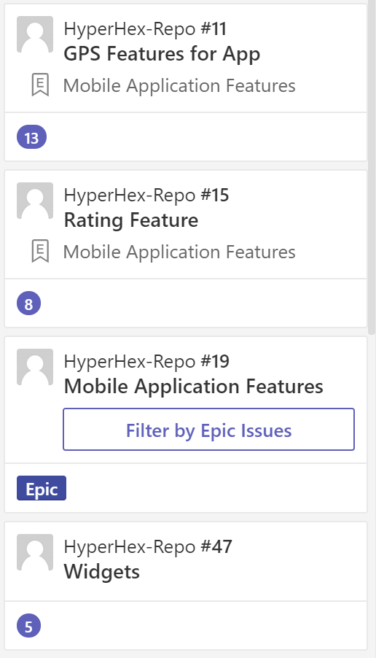
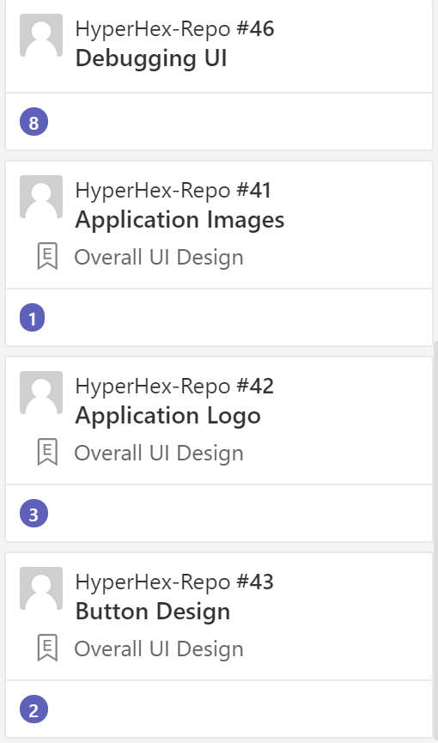
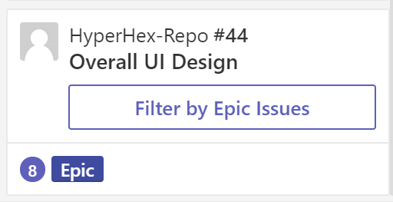
Backlog Stories

Slide 10
Questions?

